Slide 1
Performance Tuning
by qiuzhiwei

Slide 2
File System:XFS
XFS is a high-performance journaling file system created by Silicon Graphics, Inc. It was the default file system in IRIX releases 5.3 and onwards and later ported to the Linux kernel. XFS is particularly proficient at parallel IO due to its allocation group based design. This enables extreme scalability of IO threads, filesystem bandwidth, file and filesystem size when spanning multiple storage devices.

Slide 3
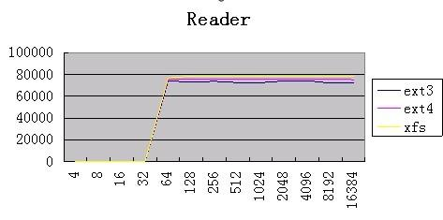
IOZONE:EXT* VS XFS

Slide 4
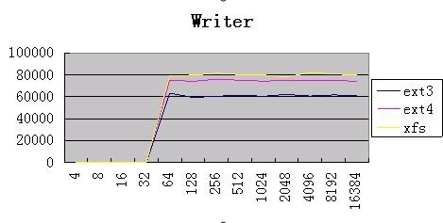

Slide 5
On a busy MySQL system there will be few major access patterns:
a) Synchronous reads for InnoDB page-ins

Slide 6
On a busy MySQL system there will be few major access patterns:
a) Synchronous reads for InnoDB page-ins
b) Asynchronous writes for InnoDB page-outs

Slide 7
On a busy MySQL system there will be few major access patterns:
a) Synchronous reads for InnoDB page-ins
b) Asynchronous writes for InnoDB page-outs
c) Synchronous overwrites for InnoDB transaction-log

Slide 8
On a busy MySQL system there will be few major access patterns:
a) Synchronous reads for InnoDB page-ins
b) Asynchronous writes for InnoDB page-outs
c) Synchronous overwrites for InnoDB transaction-log
d) Synchronous appends for MySQL binary log

